Slide 1
Namma Yatri Visualisation Analysis
By
Sana Aafreen

Slide 2
Objectives
Analyzing
Analyze Trip Durations:
The data includes trip durations categorized into hourly intervals (e.g., 0-1, 1-2, etc.).
This helps in understanding peak hours and optimizing resource allocation.
Evaluating
Evaluate Assembly Locations:
The sheet lists various assembly locations, which can be used to analyze trip distribution across different areas.
This can aid in identifying high-demand areas and improving service coverage.
Assessing
Assess Payment Methods:
Different payment methods (cash, UPI, debit card, credit card) are recorded.
This helps in understanding customer preferences and improving payment processing systems.
Monitoring
Monitor Trip Metrics:
Detailed metrics such as searches, estimates, quotes, cancellations, and ride completions are included.
These metrics are crucial for evaluating the efficiency of the service and identifying areas for improvement.

Slide 3
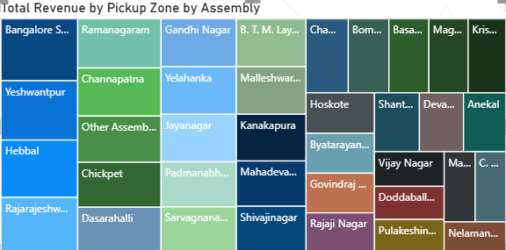
Revenue Distribution by Pickup Zone and Assembly
The image is a treemap(heatmap) chart titled "Total Revenue by Pickup Zone by Assembly."
It visualizes the revenue contributions from various pickup zones, with each zone represented by a coloured rectangle.
The size of each rectangle indicates the relative revenue contribution of that zone.
Notable zones include Bangalore South, Ramanagaram, Gandhi Nagar, and many others.

Slide 4
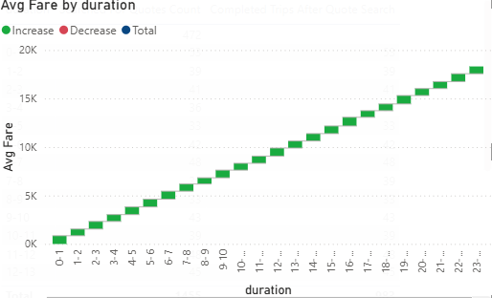
Average Fare Increases with Trip Duration
The image is a line graph titled "Avg Fare by Duration."
It shows the average fare over different durations, with the x-axis representing the duration in hours (from 0-1 to 23) and the y-axis representing the average fare in thousands (K).
The green line indicates that the average fare increases steadily as the duration increases

Slide 5
Overall Insights:
Operational Efficiency:
Use trip duration data to allocate resources effectively during peak hours.
Improve service coverage based on assembly location analysis.
Customer Experience:
Analyze payment method preferences to streamline payment processes.
Monitor trip metrics to reduce cancellations and improve ride completion rates.
Strategic Planning:
Identify high-demand areas and plan for expansion or increased service in those regions.
Use data-driven insights to make informed business decisions and improve overall service quality.
Performance Monitoring:
Regularly review trip metrics to ensure operational efficiency and customer satisfaction.
Implement changes based on data analysis to continuously improve the service.

